Slide 1



Full Trust Code Replacement PnP Transformation Process
<Consultant Name>
<Company>
<Date>

Slide 2






Consultant Name
Company Name
Skills
Whatever you want to tell
Contact
Email – someone@example.com
Blog – http://blogs.msdn.com
Twitter - @bestspdude
Expertise
Cloud based deliveries
Expertise
Passion for the cloud

Slide 3




Agenda
Introduction
Your current solution
Application Transformation
Next steps

Slide 4

Introduction
FTC to App model approach
Pilot Onboarding Requirements
General Onboarding Requirements
Notes:
FTC: Full Trust Code

Slide 5





Why transform to CAM?
Required for vNext
Aligns with service roadmap
Agile and faster deployments
You control release process
Notes:
Align to service roadmap
Cloud model offers new capabilities

Slide 6
FTC-App PnP Transformation Approach
Help customers analyze existing FTC solutions
What do you have? What do you try to accomplish with the current customization
What OOB features are available before writing custom code?
Help customers move FTC to App following guidance and best practice
How do you write Apps to delivery the custom functionality?
What is the best architecture and solution design?
For the scenarios requiring custom coding, can you use APP model instead?
How do you replace the existing FTC with the new solution?
General Guidance
Customer resource drives the project implementation
Guidance/training is available on MSDN and GitHub
Provide App SME support (Pilot)
Have your dev team working with Microsoft partners to jointly develop the pilot projects with guidance and patterns
Notes:
FTC: Full Trust Code
OOB: Out of Box
SME: Subject Matter Expert

Slide 7
PnP Transformation Program Overview
Customer Preparedness
FTC to App Assessment
Architecture session
Development/testing
Deployment
App hosting configuration
Leverage available resources to ramp up Dev resources
Analyzing complete inventory and help providing guidance on FTC to app roadmap
For selected scenarios provide architecture design guidance
Development and testing using the App Model
Retract FTC
Deploy App solutions
Deliverable:
Successful smoke test app to validate configuration
Deliverable:
Assessment report
Deliverable:
Architecture Design Report
Development SOW (optional)
Deliverable:
Tested solution artifacts
Deployment Guide
Deliverable:
Replace FTC by App
Project signoff
Post DB upgrade
Farm max compatibility is 15
Make hosting choice
Procure hosting infrastructure
Requirement document
FTC inventory
Final requirement document
Assessment report
Requirement document
Architecture Design
Deployment Guide
Engagement Criteria
Internal resource readiness
Set up hosting infrastructure
Complete configuration
Live demo
Requirement review
Prioritize requirements
Solution design proposal
Project management
100% customer developer resource (only when approved by Architecture Design SME)
Project management
100% customer developer resource (only when approved by Architecture Design SME)
Customer
Roles & Responsibilities
Consulting
Infrastructure design
Security
Support
Troubleshooting configuration
Assessment workshop
FTC analysis
Requirement analysis
Refine requirement
Architecture Design Workshop
Successful Proof of Concept
Consultation by Partner SMEs
Development by Partner resource + SME consultation
Consultation by Partner SMEs
Development by Partner resource + SME consultation
SPO-D operation support
MS Partner
Notes:
SOW: Statement of Work
SME: Subject Matter Expert
SPO-D: SharePoint Online Development

Slide 8
PnP Transformation Onboarding Process
Assemble the project team and train in house resources to develop the solution
3
4
Take advantage of published common scenario guidance for App design
Project implementation(within 90 days of development SOW signed off )
Jointly review the development SOW and technical SME allocation
5
2
1
Meet Developer PnP program entrance criteria
Assessment and design session with Developer PnP program SME
6
Notes:
Training offerings:
Online video training on MSDN Channel 9

Slide 9
Focus areas for PnP Transformation SMEs
In scope
Out of scope
Solution design guidance and technical support
Solution migration guidance and technical support
Infrastructural procurement and implementation
Process adjustments
Business requirement preparation
Code development and testing

Slide 10


General overview sessions
Migrating existing sites to app model
Enterprise-grade cloud
Essential productivity services
Readiness input from PnP Transformation Process
Aligning Development to service roadmap
Troubleshooting, tips and input
Flexibility and choice
Familiar and easy

Slide 11


Transform your code Providing app model patterns for common full-trust code scenarios
80+ Visual Studio projects,
15 training modules Common scenarios
Branding
Site provisioning
ECM
UX Components
And much more…
Contribute
This is open source project and open for contributions
Developer Patterns & Practices
aka.ms/OfficeDevPnP

Slide 12

Developer Patterns & Practices
Self service and administrative site provisioning tooling
Controlling and deploying branding
Creating needed UX components
Building search customizations
ECM and WCM tooling
User profile customizations
Notes:
Customer has to be on 2013, post DB upgrade, preferably post Site Collection Upgrade
They have committed schedule or plan to move to App model
They have development resource for APP
Their proposed project schedule is aligned with the PnP transformation overall schedule

Slide 13

Assessment report

Slide 14
Current solution
Initial analyses report
Key challenges
Requests

Slide 15




Current solution discussion points
What’s important for you?
Have you done analyses already?
3rd party solutions strategy?
Every functionality required?
Notes:
More a discussion slides than actually drilling to the solutions

Slide 16
PnP Transformation work process
App transformation steps
Work model for the PnP Transformation program
Schedule

Slide 17


FTC to App model transformation process
Analyze and Categorize
Define objectives per solution
Design CAM solution
Implement, test and deploy

Slide 18
Analyze FTC Solutions Requirements Use out of box where possible
Nice to Have
Not used or needed
Must Have

Slide 19
Analyze App Eligibilities for functionalities
Can port to App Model
Requires redesign
Blockers need workarounds
Hard blockers

Slide 20

Next Steps
Expectation
Pilot process
Questions

Slide 21
Proposed Project Schedule
Kick Off
Preparation
Design
Build
SPO-D FTC Scenarios | Prep |  | 2014 |  |  |  |  |  | 2015
 | May | June | July | Aug | Sept | Oct | Nov | Dec | Jan | Feb | Mar | Apr | May | June
Kick off and preparations
Assessment/Design Session
Branding
Site Provisioning
UX Components
Third Party Solutions

Slide 22


Getting started
Assemble your team
Agree time line to proceed
Review business requirements
Provider hosted environment

Slide 23
Setting up provider hosted environment
Office365 Dedicated platform
Networking configuration completed
Provider hosted apps hosted in on-premises (option 1)
MPLS link for provider hosted app platform to access Office365 Dedicated platform
End users accessing the provider hosted platform.
Provider hosted environment in Windows Azure (option 2)
If Dedicated farm is open for Internet connectivity traffic can flow from Azure to MSO
If Dedicated farm is not open for Internet, traffic can be routed through corporate network
Possible link from Azure to on-premises for routing traffic
Notes:
MPLS : Multiprotocol Label Switching

Slide 24

Questions?

Slide 25
Appendix

Slide 26
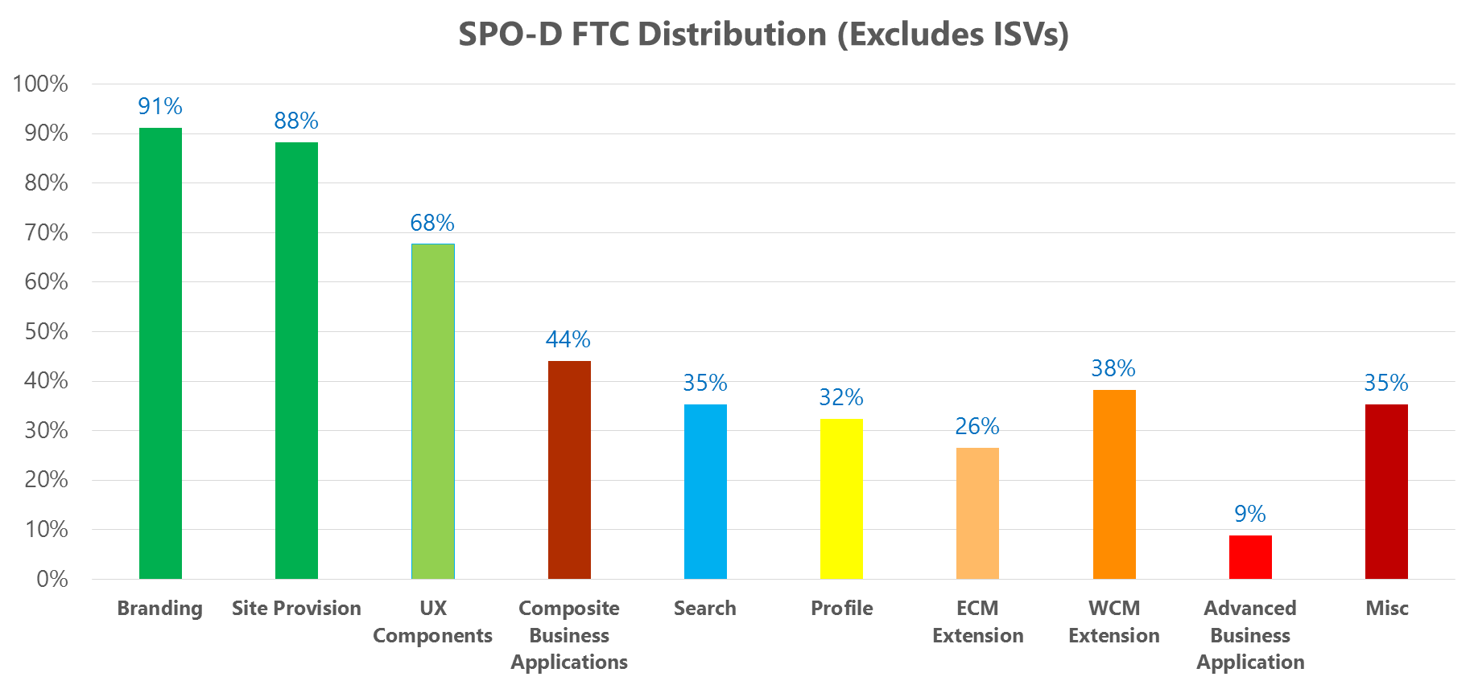
SPO-D Customers Scenario Distribution
Core Scenarios
Advanced Scenarios
Notes:
40% customers only have core scenario
Core is the building block for advanced
Advanced customization: Unique requirement that is critical to business needs

Slide 27
PnP Transformation Scenario Guidance Release Plan
SPO-D FTC Scenarios | Prep |  | 2014 |  |  |  |  |  | 2015
 | May | June | July | Aug | Sept | Oct | Nov | Dec | Jan | Feb | Mar | Apr | May | June
 | Submit CR if interest | Customer Selection
Branding
Site Provisioning
UX Components
Search
ECM Extension
Composite Business Apps
Profile
WCM Extension
Advanced WCM Extension
Advanced Business Apps

Slide 28
FTC->App Scenario Insights
Common Scenarios
Branding
Site Provisioning
Advanced Scenarios
ECM Extension
WCM Extension
UX Components
Composite Business Application
Search
Profile
Advanced Business Application
Misc.
Apply common UI elements
Site Collection/Sub site life cycle management
Reusable UX elements such as web parts, field controls used for data rendering
Functional Business Application such as business forms, business processes and composites
Search UI, Search results, Search Center extension, Search integration
People picker, profile properties extension, user profile based application
Extend core ECM functionalities, such as information management policies, record centers, retention, etc.
Publishing sites extension
Composite application with dependencies on above key elements

Slide 29
Scenario Guidance Building Blocks
Site Provisioning
Create site collections
Apply branding to sites
Update branding on existing sites
UX Components
Page manipulation
Search
Display templates
Composite Business Applications
Departmental apps
Using search API in the apps and in content
Search configuration and customizations
Showing apps and data in dialogs
Personalized UI elements
Other site modifications
Remove event receiver based modifications
Create sub sites
Approval workflow to creation
Site metadata and classification
Iterate and update “in-scope” site collections
Branding
CSS
Master Page
Theme
Web part and app part manipulation
Client side rendering
Personalized search results
Data aggregation and caching
Search center customizations
Search based site directory
Data storage models
Workflow with custom web service calls
InfoPath forms

Slide 30


© 2014 Microsoft Corporation. All rights reserved. Microsoft, Windows, and other product names are or may be registered trademarks and/or trademarks in the U.S. and/or other countries.
The information herein is for informational purposes only and represents the current view of Microsoft Corporation as of the date of this presentation. Because Microsoft must respond to changing market conditions, it should not be interpreted to be a commitment on the part of Microsoft, and Microsoft cannot guarantee the accuracy of any information provided after the date of this presentation. MICROSOFT MAKES NO WARRANTIES, EXPRESS, IMPLIED OR STATUTORY, AS TO THE INFORMATION IN THIS PRESENTATION.

